Slide 1
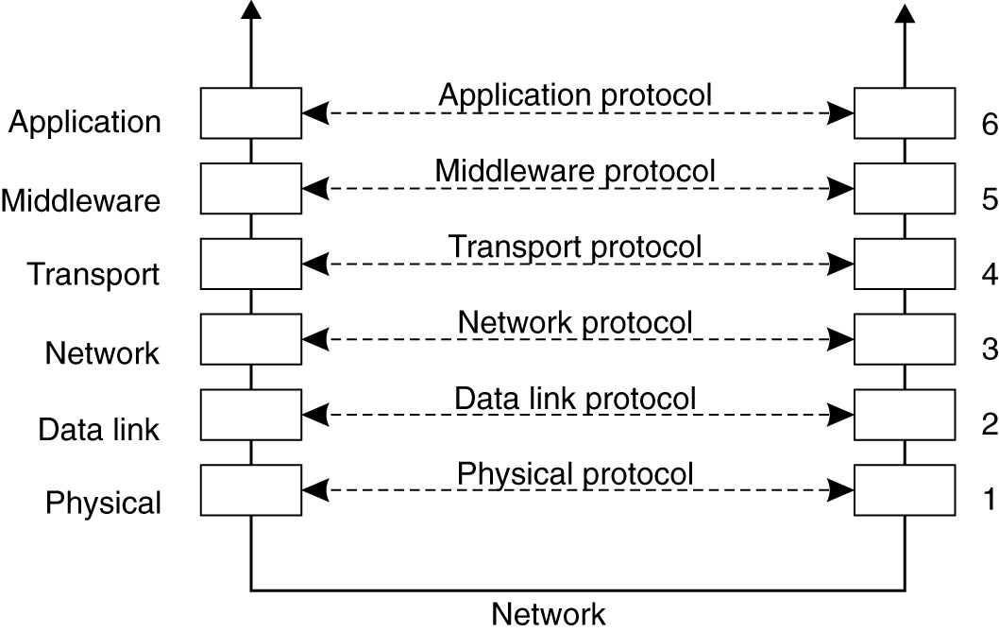
Layered Protocols (I)
Reference model for networked communication
Notes:
To make it easier to deal with the numerous levels and issues involved in networked communication, a layered reference model has been developed to clearly identify the various levels involved, giving them standard names, and pointing out which level should do which job.

Slide 2
Client-Server Communication
Assume that you are developing a client-server application:
  How to let the two processes (client and server) located on two machines communicate with each other?
    Socket programming: using functions like connect(sd, (struct sockaddr *)&sin, sizeof(sin)), write(sd, buf, strlen(buf)) etc.

Slide 3
In a distributed system, processes run on different machines.
Processes can only exchange information through message passing.
Successful distributed systems depend on communication models that hide or simplify message passing

Slide 4
Remote Procedure Call
Remote Procedure Call (RPC) is a protocol that allows programs to call procedures located on other machines.
RPC uses the client/server model. The requesting program is a client and the service-providing program is the server.
Create stub procedures to make it appear to the user that the call is local. Stub procedures contains the procedures interface
The client stub acts as a proxy for the remote procedure.
The server stub acts as a correspondent to the client stub.
Basic idea is to allow a process on a machine to call procedures on a remote machine
  Make a remote procedure possibly look like a local one
Avoid explicit message exchange between processes

Slide 5
Remote Procedure Call (RPC)
Fundamental idea: –
Server process exports an interface of procedures or functions that can be called by client programs
    similar to library API, class definitions, etc.
Clients make local procedure/function calls
  Make a remote procedure possibly look like a local one
  procedure/function call is converted into a message exchange with remote server process
  No architectural support for remote procedure calls.

Slide 6

Conventional Procedure Call
How are parameters passed in a local procedure call
  E.g., #include <sys/types.h>
  #include <unistd.h>
  ...
  char buf[20];
  size_t nbytes;
  ssize_t bytes_read;
  int fd;
  ...
  nbytes = sizeof(buf);
  bytes_read = read(fd, buf, nbytes);
  ...

Slide 7
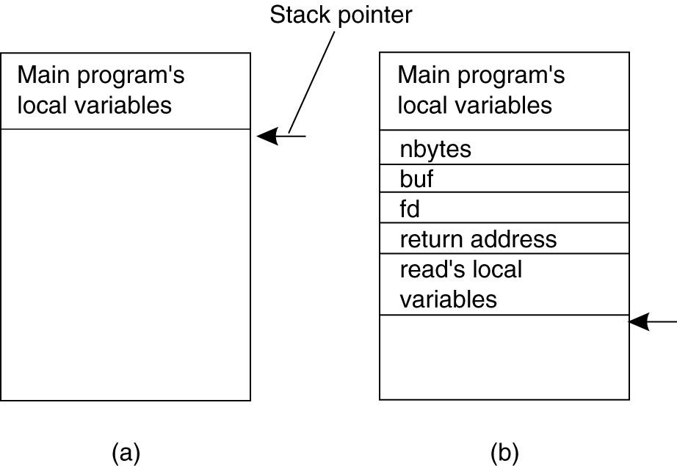
Conventional Procedure Call
Figure 4-5. (a) Parameter passing in a local procedure call: the stack before the call to read. (b) The stack while the called procedure is active.
Notes:
http://linux.die.net/man/2/read

Slide 8
Remote Procedure Calls (RPC)
How are parameter passed in a remote procedure call, while making it look like a local procedure call?

Slide 9
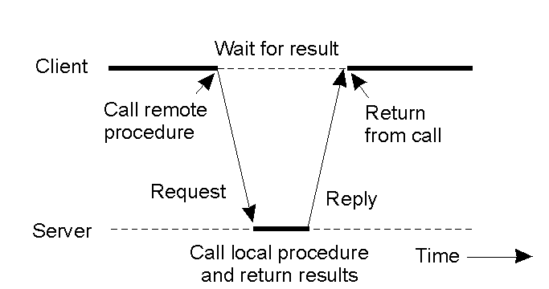
Client and Server Stubs
Principle of RPC between a client and server program.

Slide 10
RPC: The basic mechanism
Client process
Server process
Client calls a local procedure on the client stub
The client stub acts as a proxy and marshalls the call and the args.
The client stub send this to the remote system (via TCP/UDP)
The server stub unmarshalls the call and args from the client
The server stub calls the actual procedure on the server
The server stub marshalls the reply and sends it back to the client
Client
routines
Server
routines
1
5
Client stub
Server
stub
2
4
RPC
runtime
RPC
runtime
Process
Process
3
kernel
kernel
6
Network
routines
Network
routines
Source: R. Stevens, Unix Network Programming (IPC) Vol 2, 1998

Slide 11
Marshalling Arguments
Marshalling is the packing of function parameters into a message packet.
Client stub marshals the arguments into a message
Server stub unmarshals the arguments and uses them to invoke the service function
on return:
the server stub marshals return values
the client stub unmarshals return values, and returns to the client program
Machine formats differ
  Integer byte order
    Little-endian or big-endian
  Floating point format
    IEEE 754 or not

Slide 12
Stub functions
1. Client calls stub (params on stack)
client functions
server functions
client stub
server stub
(skeleton)
network routines
network routines
client
server

Slide 13
Stub functions
2. Stub marshals params to net message
client functions
server functions
client stub
server stub
(skeleton)
network routines
network routines
client
server

Slide 14
Stub functions
3. Network message sent to server
client functions
server functions
client stub
server stub
(skeleton)
network routines
network routines
client
server

Slide 15
Stub functions
4. Receive message: send to stub
client functions
server functions
client stub
server stub
(skeleton)
network routines
network routines
client
server

Slide 16
Stub functions
5. Unmarshal parameters, call server func
client functions
server functions
client stub
server stub
(skeleton)
network routines
network routines
client
server

Slide 17
Stub functions
6. Return from server function
client functions
server functions
client stub
server stub
(skeleton)
network routines
network routines
client
server

Slide 18
Stub functions
7. Marshal return value and send message
client functions
server functions
client stub
server stub
(skeleton)
network routines
network routines
client
server

Slide 19
Stub functions
8. Transfer message over network
client functions
server functions
client stub
server stub
(skeleton)
network routines
network routines
client
server

Slide 20
Stub functions
9. Receive message: direct to stub
client functions
server functions
client stub
server stub
(skeleton)
network routines
network routines
client
server

Slide 21
Stub functions
10. Unmarshal return, return to client code
client functions
server functions
client stub
server stub
(skeleton)
network routines
network routines
client
server

Slide 22
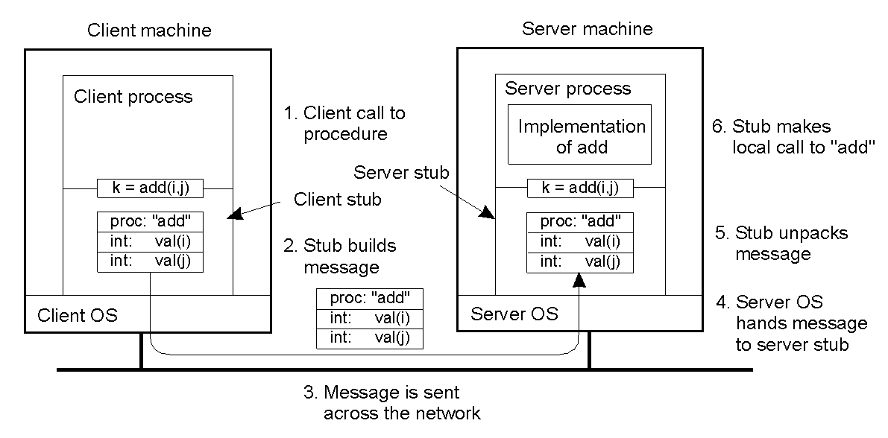
Passing Value Parameters
2-8
Steps involved in doing remote computation through RPC

Slide 23
Benefits
Procedure call interface stored in stub
Writing applications is simplified
  RPC hides all network code into stub functions
  Application programmers don’t have to worry about details
    Sockets, port numbers, byte ordering

Slide 24
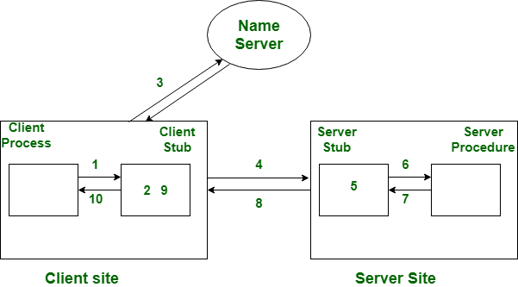

Slide 25
RPC Binding
Binding is the process of connecting the client to the server
  the server, when it starts up, exports its interface
    identifies itself to a network name server
    tells RPC runtime that it is alive and ready to accept calls
  the client, before issuing any calls, imports the server
    RPC runtime uses the name server to find the location of the server and establish a connection
The import and export operations are explicit in the server and client programs
Remote Procedure Call

Slide 26
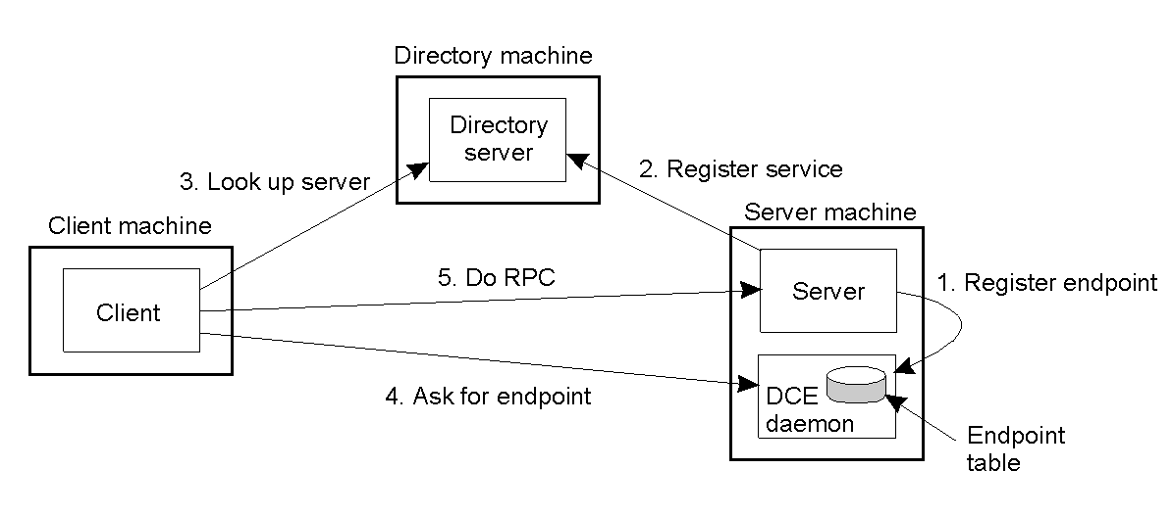
Binding a Client to a Server
2-15
Client-to-server binding in DCE.

Slide 27
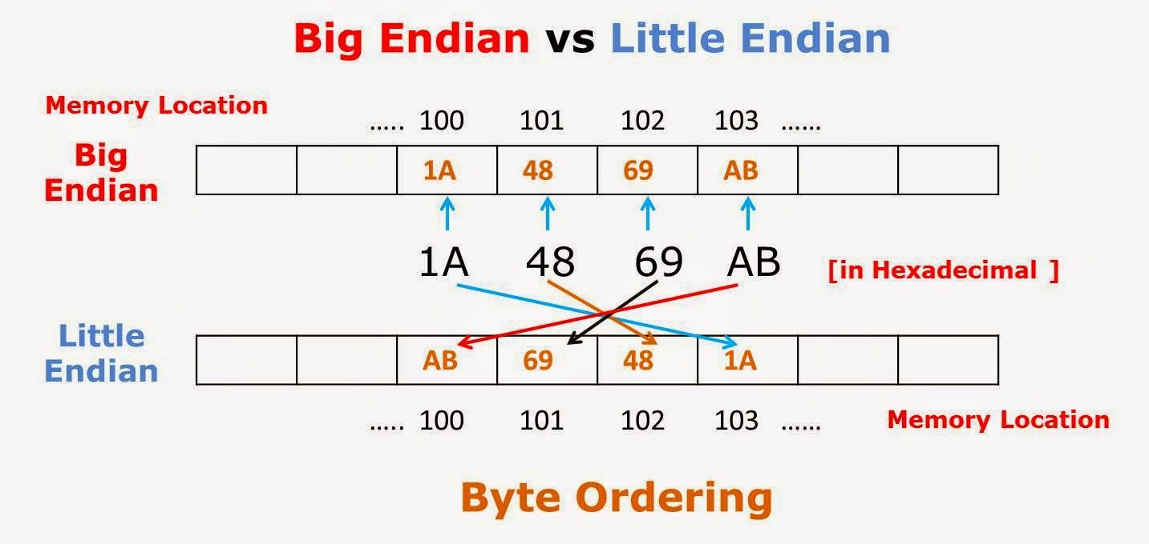
In computing, endianness refers to the order of bytes within a binary representation of a number.
Big-endian is an order in which the "big end" (most significant value in the sequence) is stored first (at the lowest storage address). Little-endian is an order in which the "little end" (least significant value in the sequence) is stored first.

Slide 28
RPC has issues

Slide 29
Issues
Are parameters call-by-value or call-by-reference?
Pass by value
  Easy: just copy data to network message
Pass by reference
  Makes no sense without shared memory
Pointers only valid within one address space
Even on same machine! Pointers are only valid within one address space. Cannot be interpreted by another process , Even on same machine!
Ct be interpreted by another process
    Even on same machine!
e only valid within one address space
Cannot be interpreted by another process

Slide 30
Parameter Passing –Value Parameters
For value parameters, value can be placed in the message and delivered directly, except …
  Are the same internal representations used on both machines? (floating point IEEE 754 or not .)
  Is the representation big endian, or little endian?

Slide 31

Passing Value Parameters
Original message on the Pentium (little-endian)
The message after receipt on the SPARC (big-endian)
The message after being inverted (integer 5, string: “LLIJ”)
Note: the little numbers in boxes indicate the address of each byte

Slide 32
Parameter Passing – Reference Parameters
Consider passing an array in the normal way:
  The array is passed as a pointer.
  The function uses the pointer to directly modify the array values in the caller’s space.
Pointers = machine addresses; not relevant on a remote machine
Solution: copy array values into the message; store values in the server stub, server processes as a normal reference parameter.

Slide 33
Pass by reference?
  Copy items referenced into message buffer
  Ship them over network
  Unmarshal data at server
  Pass local pointer to server in stub procedure.
  Send new values back

Slide 34
RMI vs RPC

Slide 35
The main difference between the two is the approach or paradigm used. RMI uses an object oriented paradigm where the user needs to know the object and the method of the object he needs to invoke.
In comparison, RPC isn’t object oriented and doesn’t deal with objects. Rather, it calls specific subroutines that are already established.
In RMI, objects are passed as a parameter rather than ordinary data.
RPC can be considered as the older version of RMI, and it is used in the programming languages that support procedural programming, and it can only use pass by value method.
As against, RMI facility is devised based on modern programming approach, which could use pass by value or reference.

Slide 36
BASIS FOR COMPARISON | RPC | RMI
Supports | Procedural programming | Object-oriented programming
Parameters | Ordinary data structures are passed to remote procedures. | Objects are passed to remote methods.
Efficiency | Lower than RMI | More than RPC and supported by modern programming approach (i.e. Object-oriented paradigms)
Overheads | More | Less comparatively
In-out parameters are mandatory. | Yes.. must have the same datatypes of input and output | Not necessarily
Provision of ease of programming | High | low

Slide 37
Remote Method Invocation (RMI) is similar to RPC but is language specific and a feature of java.
A thread is permitted to call the method on a remote object. To maintain the transparency on the client and server side, it implements remote object using stubs and skeletons.
The stub resides with the client and for the remote object it behaves as a proxy.
When a client calls a remote method, the stub for the remote method is called.
The client stub is accountable for creating and sending the message containing the name of a method and the marshalled parameters, and the skeleton is responsible for receiving the message.

Slide 38
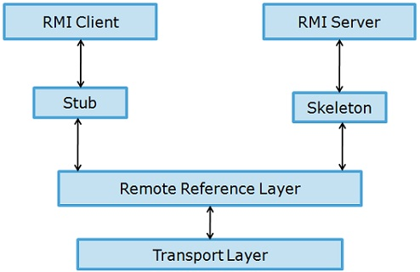
The skeleton unmarshals parameters and invokes the desired method on the server. The skeleton marshals the given value (or exceptions) with the parcel and sends it to client stub. The stub reassembles the return parcel and sends it to the client.

Slide 39
Developing distributed applications in RMI is simpler than developing with sockets since there is no need to design a protocol, which is an error prone task.
In RMI, the developer has the illusion of calling a local method from a local class file, when in fact the arguments are shipped to the remote target and interpreted, and the results are sent back to the callers.
Developing a distributed application using RMI involves the following steps:
Define a remote interface
Implement the remote interface
Develop the server
Develop a client
Generate Stubs and Skeletons,
start the RMI registry, server, and client

Slide 40
Define a remote interface: The remote interface Calculator.java.
The interface Calculator provides methods like addition, subtraction etc that takes a integer as an argument and returns the result.
Interface must be declared public, in order for clients to be able to load remote objects which implement the remote interface.
It must extend the Remote, to fulfill the requirement for making the object a remote one.
Implement the remote interface: The next step is to implement the interface Calculator.
In addition to implementing the Interface, the calculator server class is extending the UnicastRemoteObject. This indicates it is used to create a single, non-replicated, remote object

Slide 41
Develop the server
Create an instance of the remote object .
Register the object created with the RMI registry.
Naming.Rebind: Binding a name for a remote object is associating or registering a remote object that can be used at a later time to look up that remote object.
Naming. Rebind()

Slide 42
Develop a client :
The client remotely invokes any methods specified in the remote interface.
Create a client that connects to the server object using Naming.lookup()
Running the Application:
In order to run the application, we need to
generate stubs and skeletons,
compile the server and the client,
start the RMI registry,
and finally start the server and the client.

Slide 43
To generate stubs and skeletons,
use the rmic compiler: prompt> rmic calculatorserver
This will generate two files: calculatorserver_Stub.class and calculatorserver _Skel.class.
The next step is to compile the server and the client. Use the javac compiler to do this.
Finally, it is time to start the RMI registry
use the command rmiregistry or start rmiregistry on Windows.
Once the RMI registry is running, you can start the server and then client

Slide 44
Create an interface.
Create a class that implements the interface.
Create a server that creates an instance of this class
Create a client that connects to the server object using Naming.lookup()
Compile these classes.
Run interface implementation : rmic
Start the RMI registry
Start the server
Run the client

Slide 45
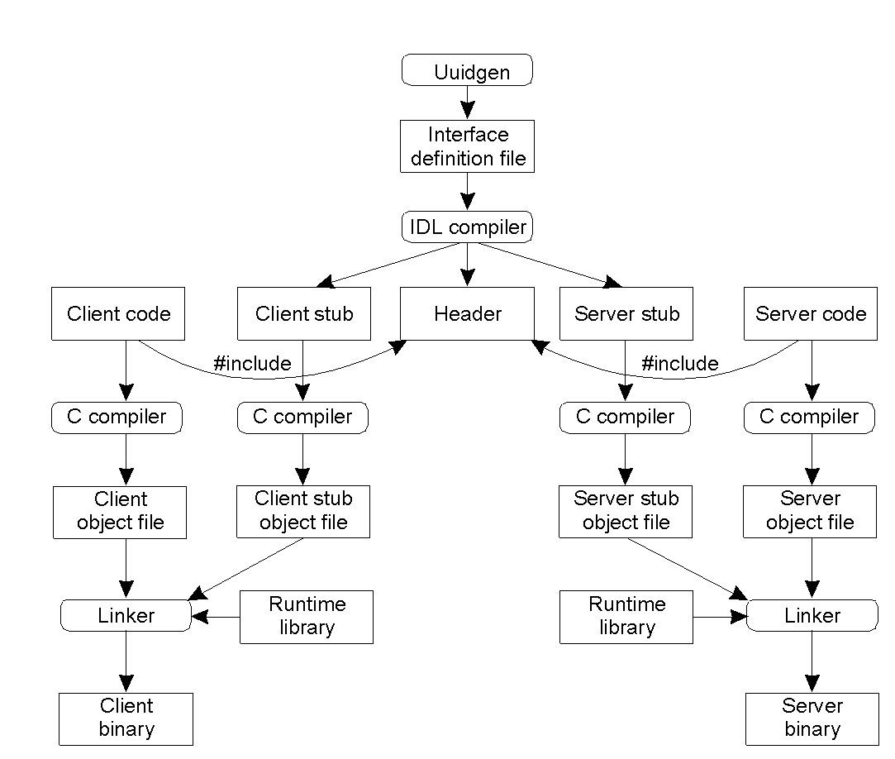
Writing a Client and a Server
2-14
The steps in writing a client and a server in DCE RPC.

Slide 46


Slide 48
RPC in Practice - DCE RPC
The Distributed Computing Environment (DCE) RPC is developed by the Open Software Foundation (OSF)/Open Group.
DCE is a middleware executing as an abstraction layer between (network) operating systems and distributed applications.
Microsoft derived its version of RPC from DCE RPC (e.g., MIDL compiler, etc.)
DCE includes a number of services:
  Distributed file service
  Directory service
  Security service
  Distributed time service

Slide 49
DCE RPC
The main goal of the DCE RPC is to make it possible for a client to access a remote service by simply calling a local procedure.
Developing a RPC application:
  Writing a client and a server: Let the developer concentrate on only the client- and server-specific code; let the RPC system (generators and libraries) do the rest. Interface Definition Language (IDL) is used to specify the variables (data) and functions (methods).
  Binding a client to a server
  Performing an RPC

Slide 50
Client-to-Server Binding (DCE RPC)
Issues: Client must locate server machine and locate the server.
Execution of Client and Server
  The server registers its procedures with the portmapper.
  Client must locate server machine: The client contacts the portmapper to determine which port the server is listening to.
  The client communicates with the server on the assigned port.
DCE uses a separate daemon for each server machine.

Slide 51
RPC ISSUES
Issues that must be addressed:
1. RPC Runtime: RPC run-time system, is a library of routines and a set of services that handle the network communications that underlie the RPC mechanism. In the course of an RPC call, client-side and server-side run-time systems’ code handle binding, establish communications over an appropriate protocol, pass call data between the client and server, and handle communications errors.

Slide 52
2. Stub: The function of the stub is to provide transparency to the programmer-written application code.
On the client side, the stub handles the interface between the client’s local procedure call and the run-time system, marshaling and unmarshaling data, invoking the RPC run-time protocol, and if requested, carrying out some of the binding steps.
On the server side, the stub provides a similar interface between the run-time system and the local manager procedures that are executed by the server.
3. Binding: How does the client know who to call, and where the service resides?
The most flexible solution is to use dynamic binding and find the server at run time when the RPC is first made. The first time the client stub is invoked, it contacts a name server to determine the transport address at which the server resides.

Slide 53
Binding consists of two parts: Naming:
Remote procedures are named through interfaces. An interface uniquely identifies a particular service, describing the types and numbers of its arguments. It is similar in purpose to a type definition in programming languauges.
Locating:
Finding the transport address at which the server actually resides. Once we have the transport address of the service, we can send messages directly to the server.

Slide 54
Sun RPC/ONC (Open Network Computing) RPC
It is designed for client-server communication over Sun NFS network file system.
UDP or TCP can be used. Generally, if UDP is used, the message length is restricted to 64 KB, but 8 - 9 KB in practice.
The Sun XDR is originally intended for external data representation (XDR).
  Valid data types supported by XDR include int, unsigned int, long, structure, fixed array, string (null terminated char *), binary encoded data (for other data types such as lists).

Slide 55
Sun/ONC RPC
Steps to create a Sun RPC application:
  Create the IDL file (sum.x), the client main code (rsum.c), and the server function code (sum_serv.c)
  Run the RPC generator (rpcgen sum.x) to generate client stub (sum_clnt.c), server stub (sum_svc.c), header file (sum.h), and data coversion file (sum_xdr.c).
  Compile the client and server programs (make).
  Start the server (server).
  Run the client (rsum hostname 10).

Slide 56
Interface Definition Language
The notation of Sun RPC IDL:
  a program number and a version number are supplied.
  The procedure number is used as a procedure definition.
  Single input parameter and output result are being passed.

Slide 57
Files interface in ONC IDL
const MAX = 1000;
typedef int FileIdentifier;
typedef int FilePointer;
typedef int Length;
struct Data {
int length;
char buffer[MAX];
};
struct writeargs {
FileIdentifier f;
FilePointer position;
Data data;
};
struct readargs {
FileIdentifier f;
FilePointer position;
Length length;
};
program FILEREADWRITE {
version VERSION {
void WRITE(writeargs)=1; 1
Data READ(readargs)=2; 2
}=2;
} = 9999;

Slide 58
Sun/ONC RPC
The interface compiler rpcgen can be used to generate the following from the interface definition.
  client stub procedures (sum_clnt.c)
  server main procedure, dispatcher (system calls) and server stub procedures (sum_svc.c)
  XDR marshalling and unmarshalling procedures used by dispatcher and client, server stub procedures. (sum_xdr.c)
Binding:
  portmapper records program number, version number, and port number.
  If there are multiple instance running on different machines, clients make multicast remote procedure calls by broadcasting them to all the port mappers.

Slide 59
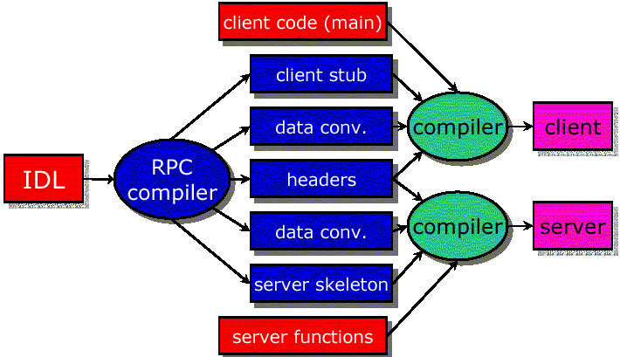
ONC RPC Interface Compiler

Slide 60
ONC RPC
Authentication:
  Additional fields are provided in the request-reply message.
  Server program should check the authentication and then execute.
  Different authentication protocols can be supported - none, UNIX style, shared key, Kerberos style.
  A field in RPC header indicates which style is used.

Slide 61
Example (ONC RPC)
long sum(long) example
  client localhost 10
  result: 55
Need RPC specification file (sum.x)
  defines procedure name, arguments & results
Run (interface compiler) rpcgen sum.x
  generates sum.h, sum_clnt.c, sum_xdr.c, sum_svc.c
  sum_clnt.c & sum_svc.c: Stub routines for client & server
  sum_xdr.c: XDR (External Data Representation) code takes care of data type conversions

Slide 62
RPC IDL File (sum.x)
struct sum_in {
long arg1;
};
struct sum_out {
long res1;
};
program SUM_PROG {
version SUM_VERS {
sum_out SUMPROC(sum_in) = 1; /* procedure number = 1*/
} = 1; /* version number = 1 */
} = 0x32123000; /* program number */

Slide 63
Example (Sun RPC)
Program-number is usually assigned as follows:
  0x00000000 - 0x1fffffff defined by SUN
  0x20000000 - 0x3fffffff defined by user
  0x40000000 - 0x5fffffff transient
  0x60000000 - 0xffffffff reserved

Slide 64
RPC Client Code (rsum.c)
#include ''sum.h''
main(int argc, char* argv[]) {
CLIENT* cl; sum_in in; sum_out *outp;
// create RPC client handle; need to know server's address
cl = clnt_create(argv[1], SUM_PROG, SUM_VERS, ''tcp'');
in.arg1 = atol(argv[2]); // number to be squared
// Call RPC; note convention of RPC function naming
if ( (outp = sumproc_1(&in, cl)) == NULL)
err_quit(''%s'', clnt_sperror(cl, argv[1]);
printf(''result: %ld\n'', outp->res1);
}

Slide 65
RPC Server Code (sum_serv.c)
#include "sum.h"
sum_out* sumproc_1_svc (sum_in *inp, struct svc_req *rqstp)
{ // server function has different name than client call
static sum_out out;
int i;
out.res1 = inp->arg1;
for (i = inp->arg1 - 1; i > 0; i--)
out.res1 += i;
return(&out);
}
// server's main() is generated by rpcgen

Slide 66
Compilation Linking
rpcgen sum.x
cc -c rsum.c -o rsum.o
cc -c sum_clnt.c -o sum_clnt.o
cc -c sum_xdr.c -o sum_xdr.o
cc -o client rsum.o sum_clnt.o sum_xdr.o
cc -c sum_serv.c -o sum_serv.o
cc -c sum_svc.c -o sum_svc.o
cc -o server sum_serv.o sum_svc.o sum_xdr.o

Slide 67
Internal Details of ONC RPC
Initialization
  Server runs: register RPC with port mapper on server host (rpcinfo –p)
  Client runs: clnt_create contacts server's port mapper and establishes TCP/UDP connection with server
Client
  Client calls local procedure (client stub: sumproc_1), that is generated by rpcgen. Client stub packages arguments, puts them in standard format (XDR), and prepares network messages (marshaling).
  Network messages are sent to remote system by the client stub.
  Network transfer is accomplished with TCP or UDP.

Slide 68
Internal Details of ONC RPC
Server
  Server stub (generated by rpcgen) unmarshals arguments from network messages. Server stub executes local procedure (sumproc_1_svc) passing arguments received from network messages.
  When server procedure is finished, it returns to server stub with return values.
  Server stub converts return values (XDR), marshals them into network messages, and sends them back to client
Back to Client
  Client stub reads network messages from kernel
  Client stub returns results to client function

